Slide 1




US Education expenditure project
Group 4 Green:
Data Set used: https://www.kaggle.com/noriuk/us-education-datasets-unification-project
Data Description:
Our data set is comprised of 25 years (1992-2017) of all 50 states, including grade levels
Kindergarten through 12th Grade (Senior of High School) financial, enrollment, and
achievement data of Public U.S. Education.
What story are we telling?
We want to find:
Top 5 States with mean expenditure over a 10 year period.
Bottom 5 States with mean expenditure over a 10 year period.
Top 5 States with highest average Math scores for Grade 4 and Grade 8.
Top 5 states with highest average reading scores for Grade 4 and Grade 8.
Top 5 states with highest expenditure per student per year.
Bottom 5 states with lowest expenditure per student per year.

Slide 2
Libraries and submodules Used
pandas
matplotlib
numpy
animation
pyplot
gridspec
Challenges Faced
Data Cleanse
Creating frames
Creating animations
Learnt Lessons
Removing duplicates is very essential for data calculations.
Watch for Kernel versions
Features in library versions
Tricks to watch for
Minimize duplicated efforts

Slide 3
Data Visualizations
Bar Charts
Animated Scatter Plot
Bar Charts are used to address below story points.
Top 5 States with mean expenditure over a 10 year period.
Bottom 5 States with mean expenditure over a 10 year period.
Top 5 States with highest average Math scores for Grade 4 and Grade 8.
Top 5 states with highest average reading scores for Grade 4 and Grade 8.
Animated Scatter Plot is used for.
Top 5 states with highest expenditure per student per year.
Bottom 5 states with lowest expenditure per student per year.

Slide 4
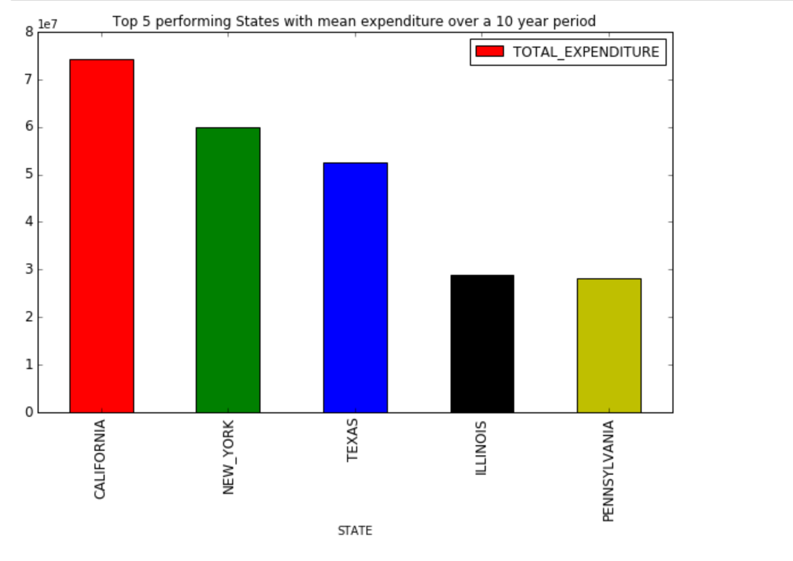

Slide 5
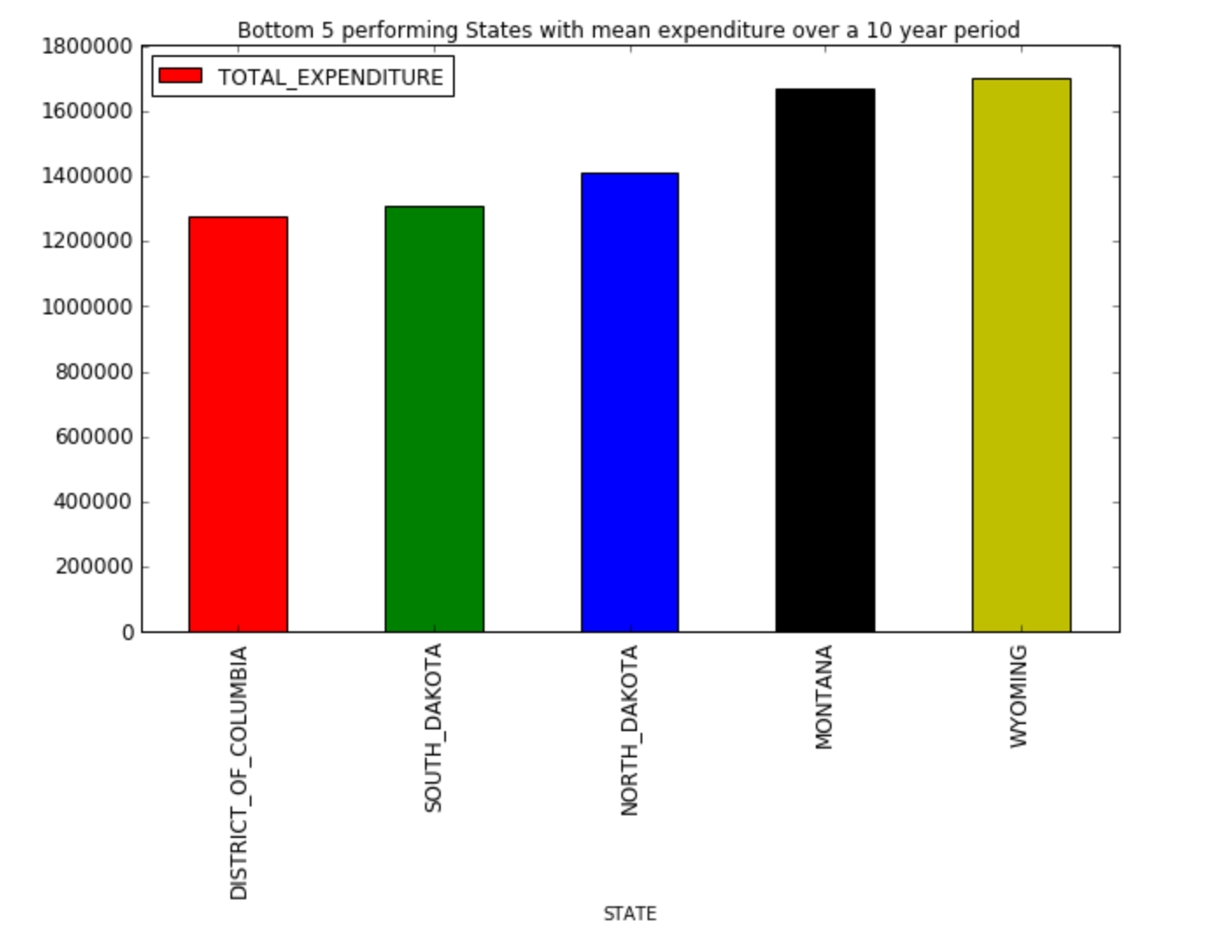

Slide 6
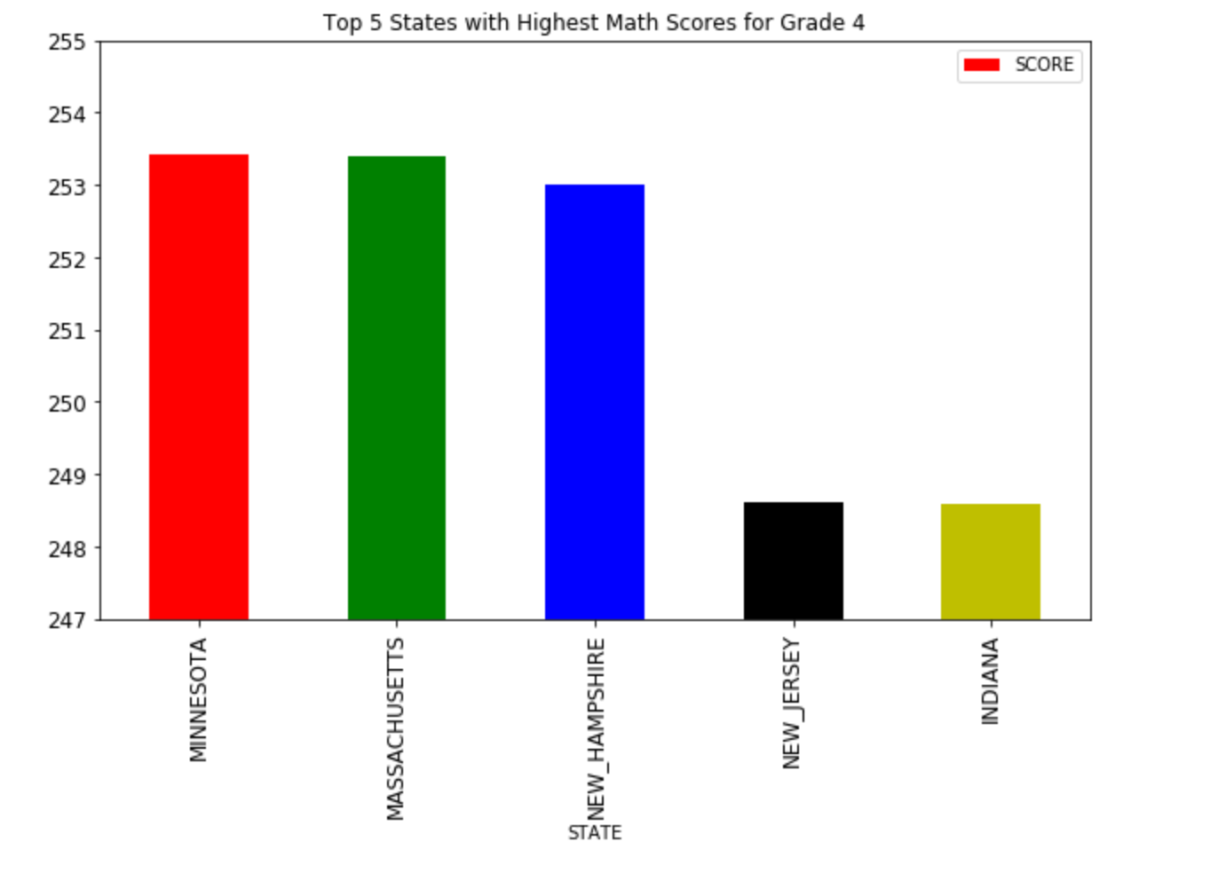

Slide 7
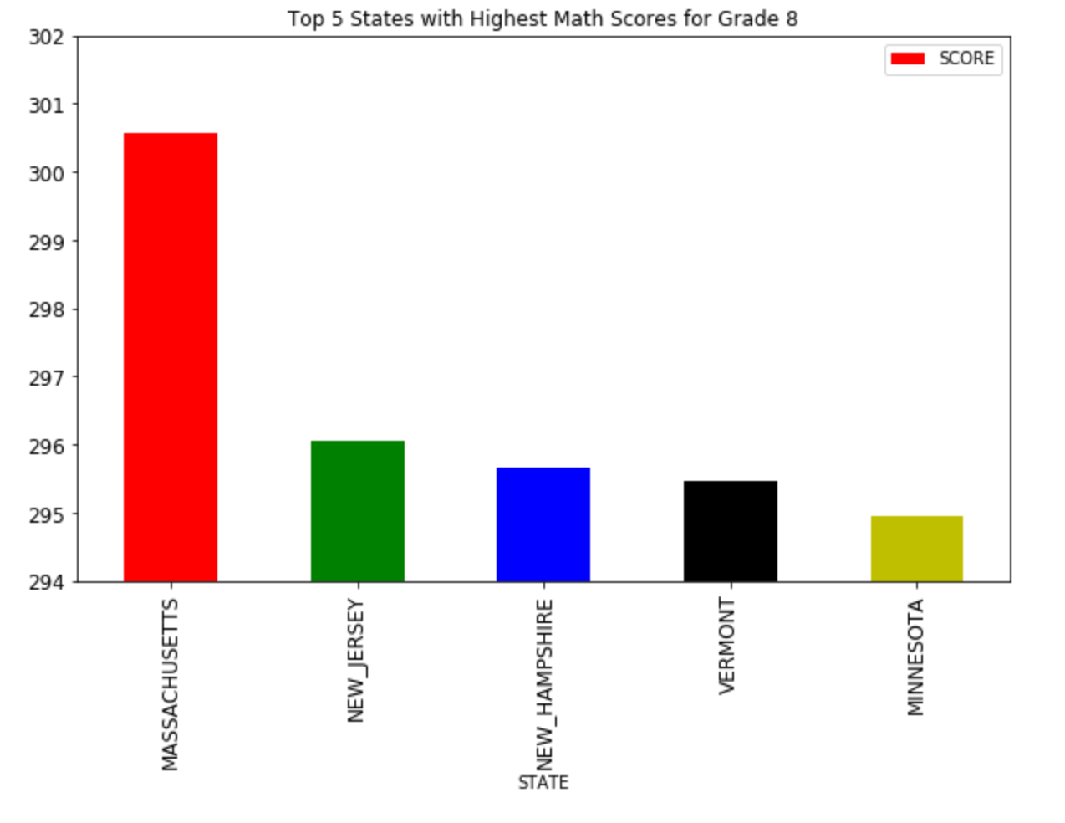

Slide 9
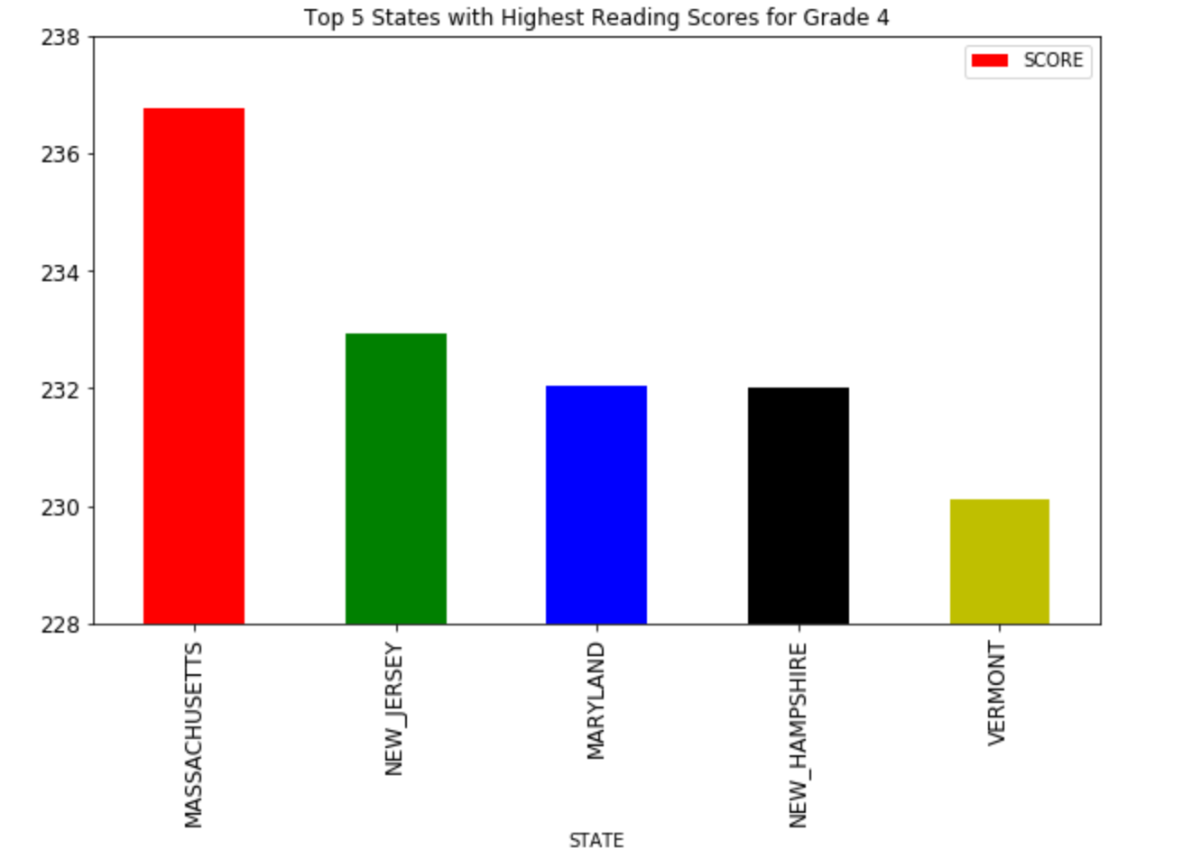

Slide 10
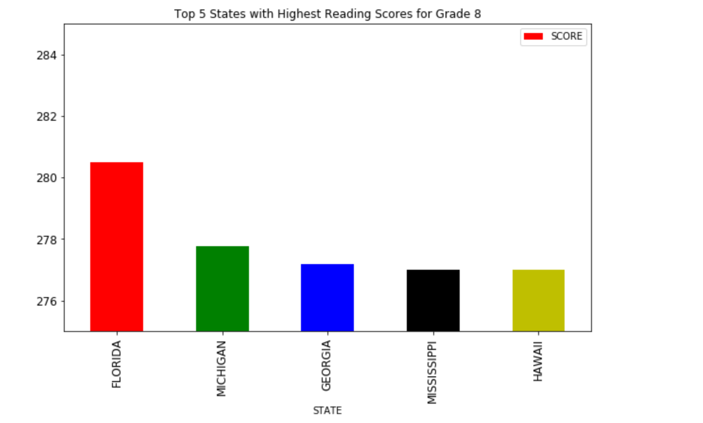

Slide 11
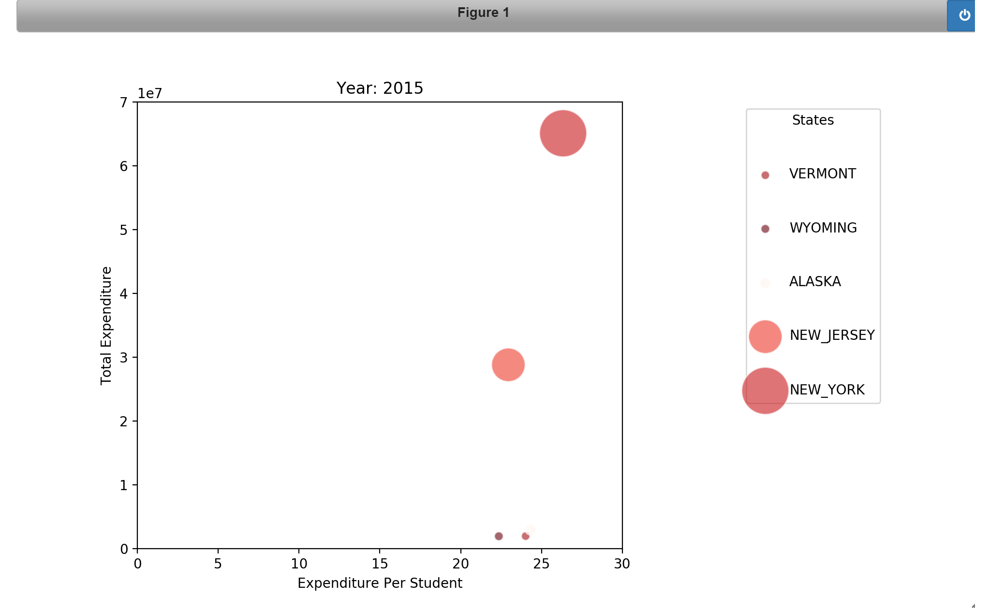

Slide 12
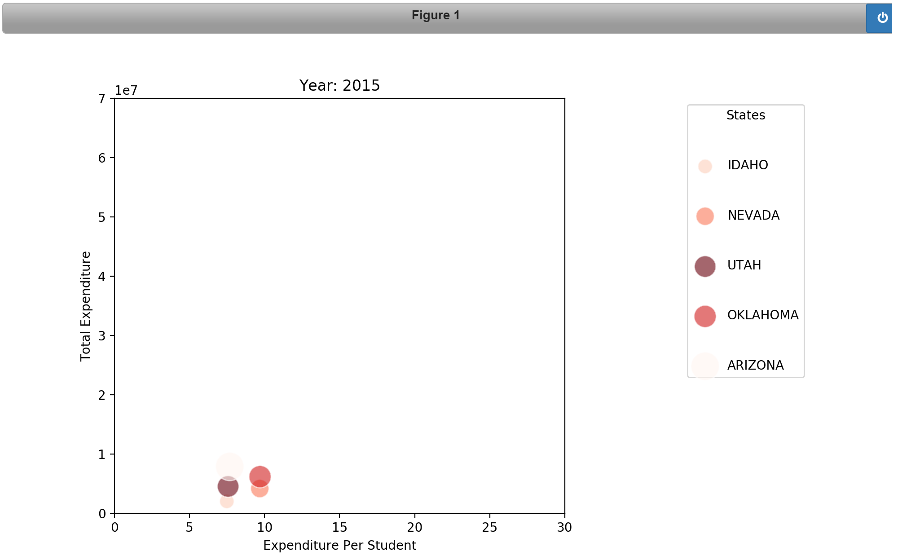

Slide 13
Questions ?

